Slide 1



Singapore Community Help Social Network
Graduate certificate in Practical Language Processing
Project PROPOSAL presentation
Siva Krishna THOTA

Slide 2
About The Project
Community help is a social network website based on Singapore to connect group of people and share useful information like other social network people can post tweets, likes and share text, images & videos through this website. Unlike other social networks, there is special feature which focus more on community interaction to help people and news sharing.
Features :
User is allowed to find near by shops/food courts in and around the community and can also explore on more offers.
Allow users to find friends in near communities.
Merchants will receive the notifications if a user request for particular item from near by communities
Seller/Buyer can post and get the news or offers from near by community.
Based on history and interest user will get notifications on mobile app by tracking user location.
Similar like whatsup groups can be created in this application.

Slide 3
Business problem statement
Problem statement # 1
When multiple users posted multiple tweets which leads to mass data could create nonuser friendly application. As a result, Posted data need to be segregated into categories
Problem statement # 2
Sentiment analysis is perfect for customer insights because you can identify sentiments in social mentions, hashtags, posts, comments, and videos. With sentiment analysis on community help , you can discover and attract new target audiences, and improve your brand presence . .
Problem statement # 2
translation is necessary because it can significantly and positively impact its benefactors On the other hand, social media translation can also be used as outputs to improve the popularity and accessibility of the business. Instead of broadening the market holistically, you can also choose specific audiences to engage in your posts. Translating and speaking using their everyday vernacular is one way to spark their interest.

Slide 4
Technical Problem Statement
Problem statement # 1 Classification and detection problem statement The aim of this business use case is to develop a model that uses multi-label classification techniques by NLP This project focuses on Category Classification detection via text language using different kinds of machine learning and deep learning classification techniques Our goal is to build a high-accuracy model to distinguish text language into below categories.The input of our model is text language which is tweeted by end users We first preprocess these text to get input vectors, then use different classifiers to predicted type of category | Problem statement # 2 Sentiment analysis This business use case derives to develop a model that uses NLP techniques to accurately detect emotions in text data. The model can be used for sentiment analysis, customer feedback analysis, and social media monitoring. The model is trained on a dataset of text data that has been labeled with the corresponding emotions expressed in it. Positive : Happy, Love Negative : Sad, Anger Neutral
 | Category
1 | BUSINESS
2 | ENTERTAINMENT
3 | POLITICS
4 | SCIENCE & TECHNOLOGY
5 | HEALTH
6 | SPORTS
7 | WORLD NEWS
8 | ARTS & CULTURE
 | Category
9 | TASTE
10 | TRAVEL
11 | WOMEN
12 | GREEN
13 | RELIGION
14 | STYLE
15 | CRIME
16 | EDUCATION

Slide 5
Technical Problem Statement
Problem statement # 3 The Good translation is necessary because it can significantly and positively impact its benefactors Obtaining Information By Translating Other Sources Social media translation can be used as inputs to aid the building of a brand and ensure relevant decision-making. Benefits of social media translation for businesses On the other hand, social media translation can also be used as outputs to improve the popularity and accessibility of the business. Reach More People Translating the original social media posts into ones of different languages is incredibly beneficial to an enterprise. This is because the translated work can now be read by many more people who may not be fluent in the original language. Cater to Specific Audiences Instead of broadening the market holistically, you can also choose specific audiences to engage in your posts. Translating and speaking using their everyday vernacular is one way to spark their interest. What happens to brands not utilizing social media translation? However, as much as it can give benefits to those that do it, it can also be a downfall for those that choose not to translate their social media posts. This is especially true for businesses that are just starting out and need exposure to fuel them. Machine-Translation-English-to-Hindi The model translates English text to Hindi text with the help of LSTM. The project was implemented in Keras Framework on TensorFlow. An encoder was used to convert the English phrases to feature vectors that can be trained upon and a decoder converts the output vector back to normal Hindi text (utf-8). Encoder - Model Encoder takes the English data as input and converts it into vectors that is passed to an LSTM model for training. We discard the encoder output and only keep the states. Decoder - Model The decoder takes in Input the states of the encoder and the Hindi data points corresponding to the English input of Encoder. It trains an LSTM to produce the translated phrase in output. The decoder used SoftMax layer.

Slide 6
About Dataset – Category Classification
Context
This dataset contains more than 800k article from 2012 to 2022 from This is one of the biggest news datasets and can serve as a benchmark for a variety of computational linguistic tasks
Content
Each record in the dataset consists of the following attributes
Category : category in which the article was published.
Headline : the headline of the article.
Authors : list of authors who contributed to the article.
Link : link to the original news article.
short_description: Abstract of the article.
date: publication date of the article.
There are a total of 42 categories in the dataset.

Slide 7
About Dataset – Category Classification
The top-16 categories and corresponding article counts are as follows:
Category | Count
BUSINESS | 164157
ENTERTAINMENT | 172485
POLITICS | 156512
SCIENCE & TECHNOLOGY | 143755
HEALTH | 54193
SPORTS | 49013
WORLD NEWS | 46602
ARTS & CULTURE | 5032
CRIME | 5044
EDUCATION | 1895
GREEN | 4646
RELIGION | 4318
STYLE | 3755
TASTE | 3999
TRAVEL | 3813
WOMEN | 6403
Class imbalance is a common problem in machine learning that occurs when the distribution of examples within a dataset is skewed or biased. This can lead to a bias in the trained model, which can negatively impact its performance

Slide 8
Solve Imbalanced Class Problem
To solve imbalance class problem I divided dataset in to 3 blocks with 3 models

Slide 9
Data Set #1 Category Classification
BUSINESS
ENTERTAINMENT
POLITICS
SCIENCE & TECHNOLOGY
Category | Count
BUSINESS | 164157
ENTERTAINMENT | 172485
POLITICS | 156512
SCIENCE & TECHNOLOGY | 143755

Slide 10
Data Set #2 Category Classification
HEALTH
SPORTS
WORLD NEWS
Category | Count
HEALTH | 54193
SPORTS | 49013
WORLD NEWS | 46602

Slide 11
Data Set #3 Category Classification
CRIME
EDUCATION
GREEN
RELIGION
STYLE
TASTE
ARTS & CULTURE
Category | Count
ARTS & CULTURE | 5032
CRIME | 5044
EDUCATION | 1895
GREEN | 4646
RELIGION | 4318
STYLE | 3755
TASTE | 3999
TRAVEL | 3813
WOMEN | 6403

Slide 12
Dataset - Sentiment analysis
Multi-Class Text Emotion Analysis
After deep pre-processing of tweets in done (lemmatization, removal of stop words, etc.)
This dataset is comprised of 62,015 tweets from Twitter with labelled emotions of five classes
Neutral,
Anger
Sad,
Love,
Happy,

Slide 13
Dataset - Sentiment analysis
Category | Count
HAPPY | 157317
LOVE | 56203
ANGER | 62560
SAD | 138750
NEUTRAL | 75886
Class imbalance is a common problem in machine learning that occurs when the distribution of examples within a dataset is skewed or biased. This can lead to a bias in the trained model, which can negatively impact its performance

Slide 14

Dataset - Machine-Translation-English-to-Hindi
Context
The dataset consist of 1000000 English phrases along with their Hindi translations. The data is given in utf-8 format.
Content
Each record in the dataset consists of the following attributes
english_sent
hindi_sent
eng_sent_length
hindi_sent_length

Slide 15

Application Flow Phase #1
Machine-Translation
English-to-Hindi
Step #1
Step #2
Image
Message
NO
Step #8
Image Abuse
Detection
Step #4
Step #5
Step #7
Yes
Text Classification
Send Message
Rule Based
Engine
Step #3
Reply Back
To Sender
Text Abuse
Detection
Step #6
Emotion Detection
NO
Text Message
PYTHON
Intelligent Reasoning
Systems
Practical Language
Processing

Slide 16
Application Flowchart Phase #1
Post Message
Category Classification / Emotion Detection
News
Sell / Buy
Politics
Sports
Tech
Health
Promotions
Rule Based Engine
Receive Message

Slide 17
Modeling approach
Data
Preprocess the data
Data Cleaning
EDA
Multi Class
Create word embeddings
Word2Vec
Glove
Train the model
LSTM
Bi-LSTM
CNN
Test and Predict

Slide 18
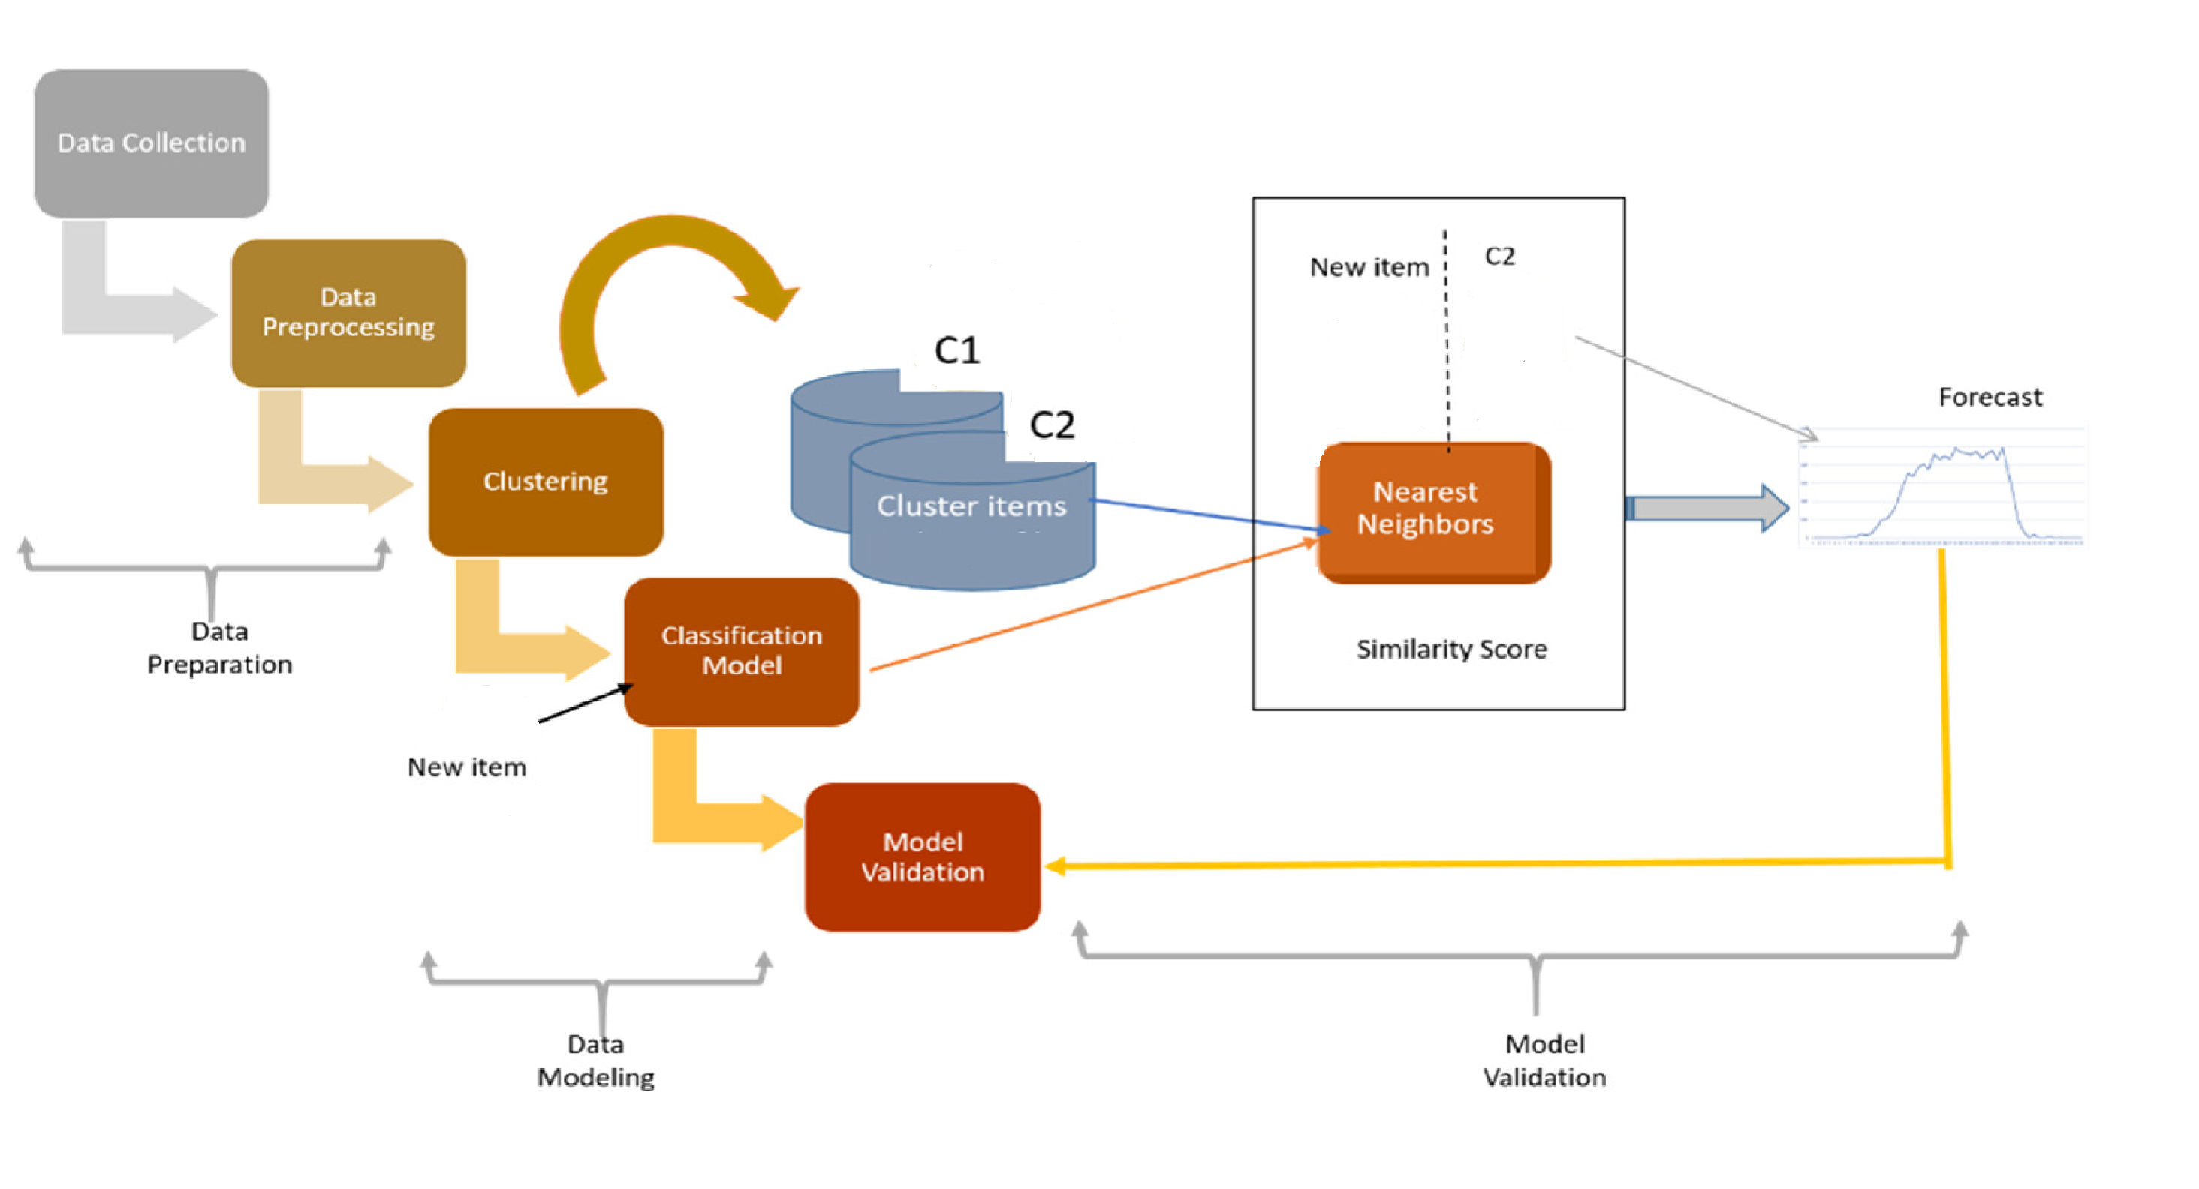
Experimental design

Slide 19
Project deliverables With Effort Estimates
Web Site built with Python using the Django Web Framework, trivial templates with Bootstrap & jQuery for UI & UX, a RESTful API for the web client using Django Rest Framework.
Design database object using SQLite
Deep learning model for sentiment analysis / Emotion detection.
Deep learning model for multi-label classification.
Task | # Days
Design Web Project / DB Design | 30 Days
Data Collection | 10 Days
sentiment analysis / Emotion detection | 10 Days
multi-label classification. | 10 Days

Slide 20
Learning Objectives
Get familiar with class imbalance through coding.
Understand various techniques for handling imbalanced data, such as Random under-sampling, Random over-sampling, and Near Miss.
Sentiment Analysis
Apply the relevant models that need to be used for each task
Apply the major guiding principles when choosing a model for a specific task within NLP
Decide when to and when not to use neural network based or deep learning methods for a specific task within NLP
Design and implement fundamental algorithms used for various NLP tasks
Analyze the time complexity involved for a specific NLP algorithm

Slide 21

RESULT

Slide 22
Done So far
Problem statement # 1 : Category classification ( Model #1,2,3 )
Completed Task
1. Data Clean & EDA.
2. Convert Text to vectors using different techniques like TFIDF ,Word2Vec
3. Trained Machine Learning and Deep Learning models.
4. Model Evaluation & Prediction using Test data
Pending Tasks
1. Model integration in community help website
2. Prediction using Real Time data

Slide 23
Done So far
Model #1
Model | Features | Accuracy
Support Vector Machine | TfidfTransformer , Ngram | 0.8923
Logistic Regression | TfidfTransformer , Ngram | 0.884
Randomforest | TfidfTransformer , Ngram | 0.6603
Model |  | Accuracy
LSTM LAYER1 | TfidfTransformer , Ngram | 0.873
GRU | TfidfTransformer , Ngram | 0.8605
Model | Features | Accuracy
MLP Classifier | Bag-of-words approach | 0.8413
Naive Bayes(Multinomial) | Bag-of-words approach | 0.8382
Logistic Regression Classifier | Bag-of-words approach | 0.7834
Support Vector Machine | Bag-of-words approach | 0.7715
Randomforest | Bag-of-words approach | 0.6172
Model #2
Model | Features | Accuracy
MLP Classifier | Bag-of-words approach | 0.906
LogisticRegression | Bag-of-words approach | 0.8613
Support Vector Machine | Bag-of-words approach | 0.8195
Randomforest | Bag-of-words approach | 0.7182
Model |  | Accuracy
LSTM LAYER1 | TfidfTransformer , Ngram | 0.8974
LSTM LAYER2 | TfidfTransformer , Ngram | 0.8921
Model #3
Model | Features | Accuracy
MLP Classifier | Bag-of-words approach | 0.8011
LogisticRegression Classifier | Bag-of-words approach | 0.7026
Support Vector Machine | Bag-of-words approach | 0.6653
Randomforest | Bag-of-words approach | 0.5664

Slide 24
Done So far
Problem statement # 2 : Sentiment analysis
Completed Task
1. Data Clean & EDA.
2. Convert Text to vectors using different techniques like TFIDF ,Word2Vec
3. Trained Machine Learning and Deep Learning models.
4. Model Evaluation & Prediction using Test data
Pending Tasks
1. Model integration in community help website
2. Prediction using Real Time data
Model | Features | Accuracy
MLP Classifier | Bag-of-words approach | 0.8679
Logistic Regression | TfidfTransformer , Ngram | 0.855
Support Vector Machine | TfidfTransformer , Ngram | 0.855
Naive Bayes(Multinomial) | TfidfTransformer , Ngram | 0.824
LogisticRegression Classifier | Bag-of-words approach | 0.8057
GradientBoostingClassifier | TfidfTransformer , Ngram | 0.8024
AdaBoost with Random Forest Classifier | TfidfTransformer , Ngram | 0.769
Randomforest | TfidfTransformer , Ngram | 0.732
Support Vector Machine | Bag-of-words approach | 0.7039
Randomforest | Bag-of-words approach | 0.67
Model |  | Accuracy
GRU | TfidfTransformer , Ngram | 0.8106

Slide 25
Done So far
Problem statement # 3 : Translation
Completed Task
1. Data Clean & EDA.
3. Trained Machine Learning and Deep Learning models.
4. Model Evaluation & Prediction using Test data
Pending Tasks
1. Model integration in community help website
2. Prediction using Real Time data

Slide 26
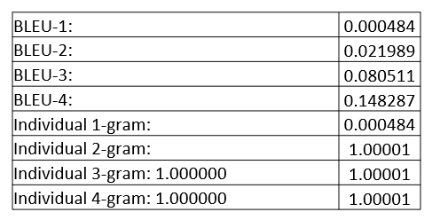
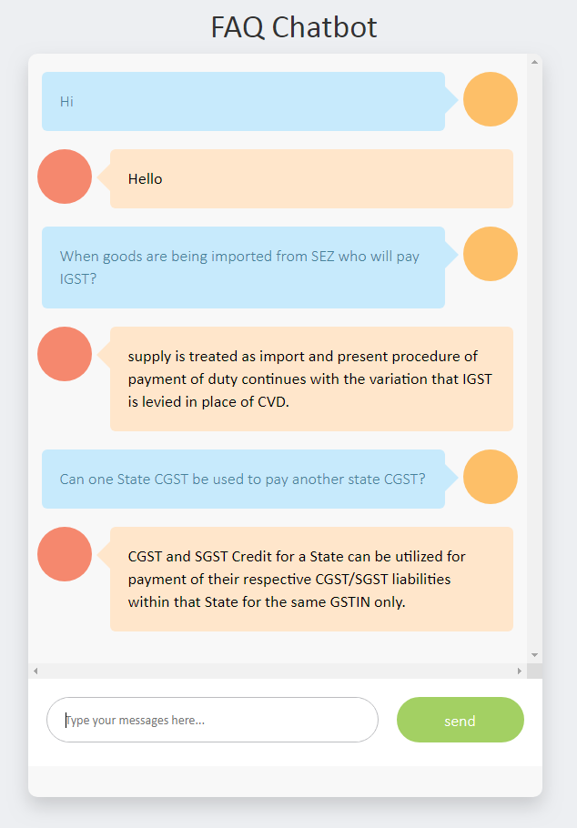
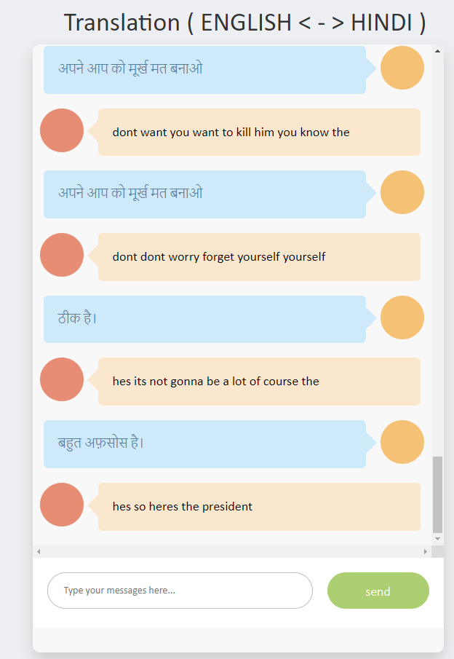
Translation & FAQ Chatbot Result
Problem statement # 3 : Translation

Slide 27
References
https://colab.research.google.com/github/d2l-ai/d2l-en-colab/blob/master/chapter_deep-learning-computation/use-gpu.ipynb#scrollTo=mwrEJrSCo-OR
https://github.com/opencv/opencv
https://www.kaggle.com/datasets/pashupatigupta/emotion-detection-from-text
https://www.analyticsvidhya.com/blog/2020/07/10-techniques-to-deal-with-class-imbalance-in-machine-learning/
https://www.kaggle.com/code/jarvis11/text-emotions-detection
https://github.com/dair-ai/emotion_dataset
https://github.com/suvaansh/Machine-Translation-English-to-Hindi-/tree/master
https://www.kaggle.com/datasets/parvmodi/english-to-hindi-machine-translation-dataset?select=train.hi
https://www.kaggle.com/datasets/vaibhavkumar11/hindi-english-parallel-corpus

Slide 28


